Slide 1
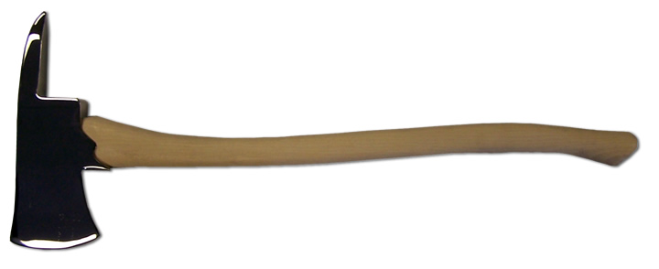
Matthew 3:7-10
7 But when he saw many of the Pharisees and Sadducees coming to his baptism, he said to them, "Brood of vipers! Who warned you to flee from the wrath to come?
8 "Therefore bear fruits worthy of repentance,
9 "and do not think to say to yourselves, ‘We have Abraham as our father.’ For I say to you that God is able to raise up children to Abraham from these stones.
10 "And even now the ax is laid to the root of the trees. Therefore every tree which does not bear good fruit is cut down and thrown into the fire.

Slide 2
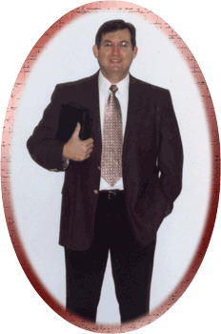
“Commonsense Questions A Church of Christ Preacher Cannot Answer?”
So says David Martin of the so-called “Rock Solid Baptist Church”
Not solid enough to let a church of Christ preacher answer his questions before his people?
David Martin

Slide 3
Of David Martin
“He is a 1984 graduate of Pensacola Bible Institute of Florida, and was ordained to the gospel ministry in 1986. He has been in his current pastorate for eight years. His article on the Church of Christ cult is the result of in-depth personal conversation with a Church of Christ elder that led to a 3-day public debate with a Church of Christ evangelist in 1997. The debate was attended by 250 people nightly from within a 300-mile radius of Memphis, Tennessee. This is one of the most controversial articles on the church of Christ you will find anywhere. No church of Christ preacher can satisfactorily answer any of the questions posed by Pastor Martin.”
(http://www.biblebelievers.com/david_martin/martin_church-christ.html)

Slide 4
3 Things To Consider
REVIEW: since Martin thinks this to is a “controversial” subject, he cannot object to any candid review of his article
SUBJECTIVE: “No church of Christ preacher can satisfactorily answer any of the questions” is subject to one’s opinion
  Stephen answered the Sanhedrin but not as they deemed “satisfactorily” (Acts 7:54-60)
YOU DECIDE: You decide whether the answers agree with God and His word!

Slide 5
Martin Wrote:
If you are a member of this "church" or have been influenced by its teachings, we challenge you to ask your preacher the questions that follow, then get your King James Bible out, open it up, and ask the Holy Spirit to show you the TRUTH (John 16:13). If you have never been saved in the Bible sense, for heaven's sake, do not mistake being "washed in the baptistry [sic. sjw] of the church" for being washed in the blood of Christ.

Slide 6
My Challenge
If you are a member of the “Rock Solid” Baptist Church, why not ask Mr. Martin why he doesn’t respond to challenges to have an open discussion?
If you are a member of the “Rock Solid” Baptist Church, do not confuse “Bible Baptism” with “Baptist Baptism”
  the former is for salvation (1 Peter 3:21)
  the latter is not for salvation (ask any Baptist preacher)

Slide 7

Martin Wrote:
If you ask one of these "preachers" any of the questions in this tract, you won't get a straight answer due to their "screwball" theology. You'll have them in "hot water," "swimming in circles," trying to explain their heretical positions. They'll be "hopping all over the pond" because they can't stay too long in one spot without sinking in the mire of their false doctrines.
REALLY?

Slide 8
Screwball Theology?
PROPOSITION FOR DEBATE:
The Scriptures teach that “He who believes and is baptized will be saved” is a screwball theology?
Affirm: David Martin?
Deny: Steven J. Wallace
Jesus The Christ
Mark 16:15, 16

Slide 9
Screwball Theology?
PROPOSITION FOR DEBATE:
The Scriptures teach that to command a penitent believer to “arise and be baptized, and wash away your sins, calling on the name of the Lord” is a screwball theology?
Affirm: David Martin?
Deny: Steven J. Wallace
Ananias
Acts 22:16

Slide 10
Screwball Theology?
PROPOSITION FOR DEBATE:
The Scriptures teach that commanding a believer to be baptized in order to be clothed with Christ is commanding a screwball theology?
Affirm: David Martin?
Deny: Steven J. Wallace
Paul The Apostle
Galatians 3:26, 27

Slide 11
Martin’s Contention
The religious sect known as the "Church of Christ" has many peculiar and aberrant doctrines that are contrary to the word of God. It is a most deceptive and dangerous cult. Their teaching of baptismal regeneration is an age-old heresy that has damned millions to hell, and is still doing so today. The idea that they are the one, true and restored church of Jesus Christ puts them in the same league with the Mormon and Roman Catholic churches.

Slide 12
Martin & Tertullus Against Truth
MARTIN
  church of Christ holds aberrant doctrines contrary to God’s word
  most deceptive and dangerous cult
  damned millions to hell
  same league with Mormons and Catholics
TURTULLUS
  this man’s a plague
  creator of dissension throughout the world
  ringleader of the sect called Nazarenes
  profaned temple (Acts 24:5, 6)

Slide 13

“But this I confess to you, that according to the Way which they call a sect, so I worship the God of my fathers, believing all things which are written in the Law and in the Prophets”
—Acts 24:14

Slide 14
LIKEWISE:
I confess to you, that according to the Way which Baptists call a CULT, so I worship God, believing all things which are written in the BIBLE!

Slide 15
Baptismal Regeneration?
Who teaches it in the church of Christ?
  Colossians 2:11, 12; Titus 3:5

Slide 16
Did Elisha Teach:
JORDAN
REGENERATION?

Slide 17
Baptismal Regeneration?
If teaching that “baptism is necessary for salvation” is teaching “baptismal regeneration,” then:
  is teaching that “repentance is necessary for salvation” teaching “penitential regeneration?” If not, why not?

Slide 18
CHARGE: Same League With Mormons/Catholics?
“The idea that they are the one, true and restored church of Jesus Christ puts them in the same league with the Mormon and Roman Catholic churches”
“Well, the idea that ‘faith is essential for salvation’ puts Martin in the same league with Mormons and Catholics?”

Slide 19
Martin Warns
Don't YOU wind up being baptized in the "Lake of Fire" by accepting a "waterworks" based plan of salvation and rejecting salvation by grace through faith in the finished work of Christ.

Slide 20

WATERWORKS PLAN?
If teaching “baptism is essential for salvation” means we teach a “waterworks-based plan,” then:
does teaching “baptism is essential for church membership” mean that they believe in a “waterworks-based church?”
  does the Baptist Church have a “waterworks-based membership?” If not, why not?

Slide 21
WATERWORKS PLAN?
If teaching “baptism is essential for salvation” means we teach a “waterworks-based plan,” then:
does the Baptist Church entrust their membership to water and not the blood of Christ and His finished work when they require baptism for membership?

Slide 22
Rejecting Salvation by Grace Through Faith in the Finished Work of Christ?
If teaching “baptism saves” rejects “grace through faith,” then:
  teaching “repentance saves” rejects “grace through faith!”
    If “baptism” rejects grace, how does “repentance” not reject it (Acts 2:38)?

Slide 23
Mark Versus Martin
“He who believes and is baptized will be saved; but he who does not believe will be condemned” (Mark 16:16)
  “He who believes and is baptized to be saved rejects salvation by grace through faith and is in danger of being baptized in fire; but he who has faith alone will be saved” (Martin 16:16)

Slide 24
Rejecting Salvation by Grace Through Faith in the Finished Work of Christ?
Martin must charge apostles for rejecting salvation by grace through faith
  “…the Divine longsuffering waited in the days of Noah, while the ark was being prepared, in which a few, that is, eight souls, were saved through water. There is also an antitype which now saves us—baptism (not the removal of the filth of the flesh, but the answer of a good conscience toward God), through the resurrection of Jesus Christ”
    1 Peter 3:20, 21

Slide 25
Rejecting Salvation by Grace Through Faith in the Finished Work of Christ?
Martin must charge apostles for rejecting salvation by grace through faith
  “Much more then, having now been justified by His blood, we shall be saved from wrath through Him. For if when we were enemies we were reconciled to God through the death of His Son…” (Rom. 5:9, 10)
  “What shall we say then? Shall we continue in sin that grace may abound? Certainly not! How shall we who died to sin live any longer in it?” (Rom. 6:1, 2)?
??
??
WHEN??

Slide 26
Rejecting Salvation by Grace Through Faith in the Finished Work of Christ?
Martin must charge apostles for rejecting salvation by grace through faith
  “Or do you not know that as many of us as were baptized into Christ Jesus were baptized into His death?” (Rom. 6:3)
!!

